Slide 1

Inventory and Cost analysis
Marcelo Ortiz

Slide 2
Inventory and Cost Analysis
1. Cost Assignment
2. Traditional Full Costing
3. ABC

Slide 3
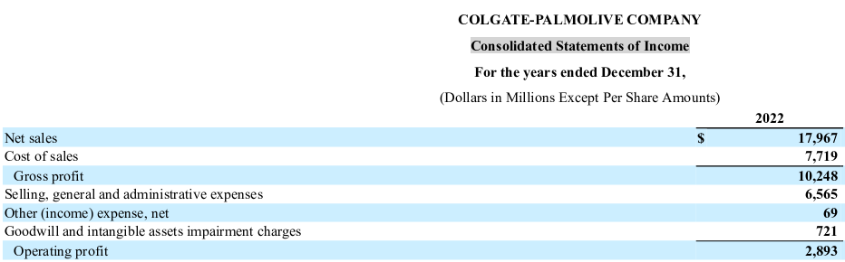
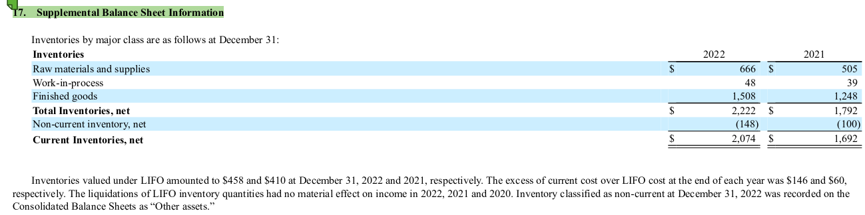
1. Cost Assignment
In previous sections, we covered Inventories (topic 3) and Income Statement (topic 4).
The focus of this topic is to learn
(1) What costs are reported as Cost of Sales or SG&A?
(2) Timing of the cost recognition.
(3) Cost assignment across product lines.
2. Traditional Full Costing
3. ABC/ABM

Slide 4
1. Cost Assignment
Inventory costs -> Cost of Sales
Inventory costs: All costs of purchasing, converting, or bringing inventories to their present location and condition.
Not all of them are capitalized in the year-end inventory value
Some of them are expenses in the current year.
The key is classifying the item as a product or periodic expense.

Slide 5
1. Cost Assignment
Product Costs
All costs directly tied with the acquisition or production of goods.
Periodic Costs
Expensed as ocurred.
Manufacturing firms:
Direct material
Direct labor
Overhead (rent and utilities of the manufactoring plants)
acquisition costs.
Merchandising firms:
"Other operating expenses":
Selling costs
Capitalized in the inventory balance and expensed when the product is sold.
Marketing and advertising costs
Salaries and comission for sales staff
Abnormal waste of material during production
Product storage costs
SG&A expenses:
Administrative expenses

Slide 6
1. Cost Assignment
A) How much is the total cost capitalized in "inventory" at year-end?
B) How much are the total period expenses for the year?
C) How much are the "other operating expenses" and "SGA expenses"?
Cost | Amount ($)
Raw material transportation costs | 3,500
Google ads expenses | 400
Finished goods transportation cost to clients | 2,100
Warehouse personnel - salaries | 10,000
Purchase cost of materials | 40,000
Furniture designers and constructors - salaries | 11,000
Storage costs | 4,200
Abnormal waste | 1,300
Manufacturing overhead | 9,000
Office supplies | 200
Sales comissions | 700
Notes:
Product costs: 3500+40000+11000+9000=63,500
Periodic costs: 400+2100+10000+4200+1300+200+700=18,900
Out of which:SGA=400+2100+200+700=1,300
Out of wich other expenses=10000+4200+1300
Total=82.400

Slide 7
1. Cost Assignment
Given the previous cost structure, discuss
Product cost:
% variable costs
How sensible is the Gross Margin to the distribution of variable costs?
% Product vs Periodic costs:
Economic boom or sharp production increase: is the firm really more profitable?
Notes:
If % variable is low, it means that COGS will be very sticky across time, meaning that variations in revenues will not be joined by variations in COGS.
In those cases, using past gross margin to predict future is not smart.

Slide 8
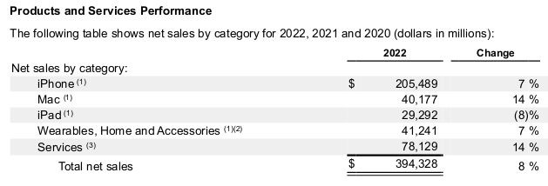
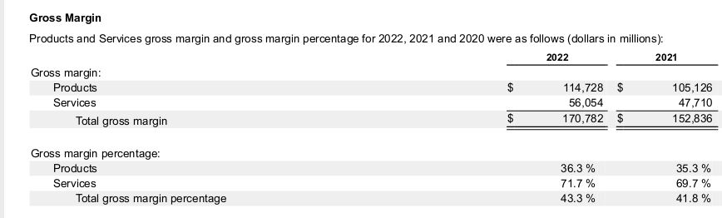
1. Cost Behavior Patterns and Assignment
2. Traditional Full Costing
In many cases, the financial reports include information on sales and operating margin per product line or service.
So now we will learn two methods companies use to decompose "product costs" across several product/service lines.
A) Traditional method
B) ABC method
3. ABC/ABM

Slide 9
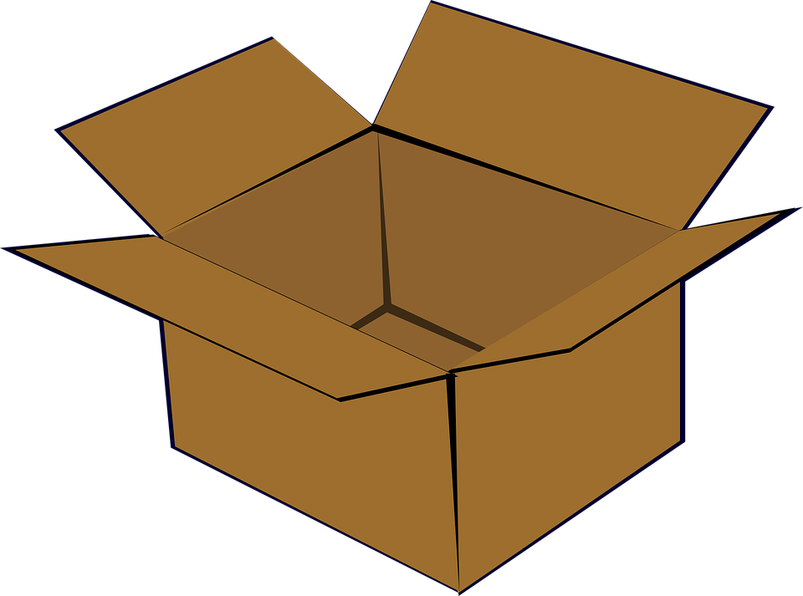


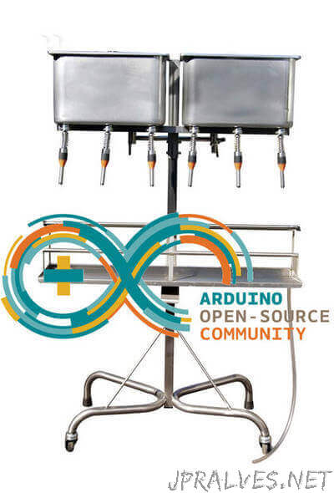
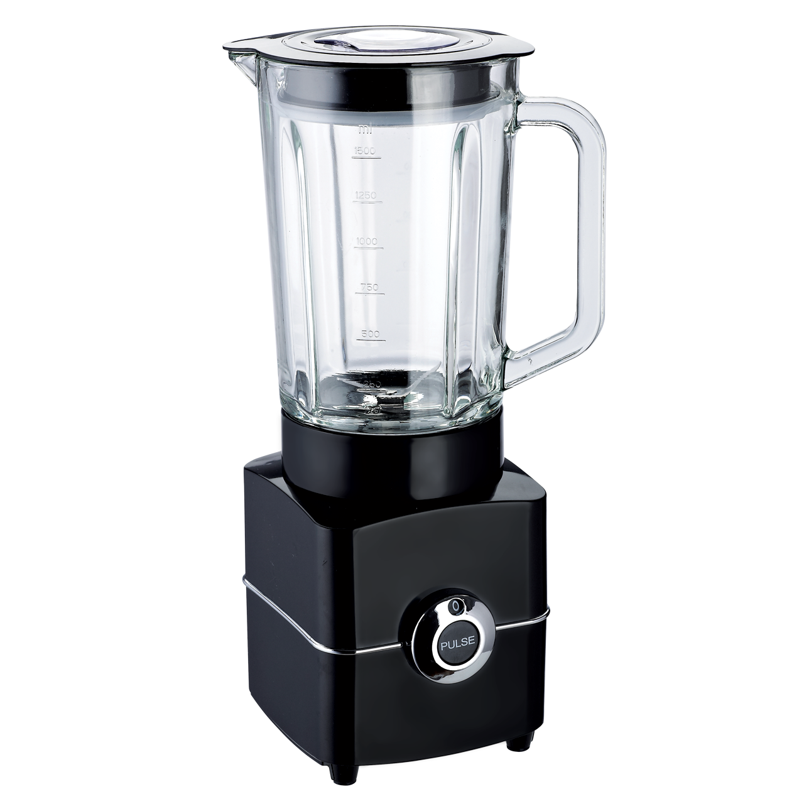

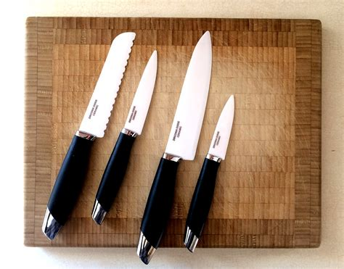
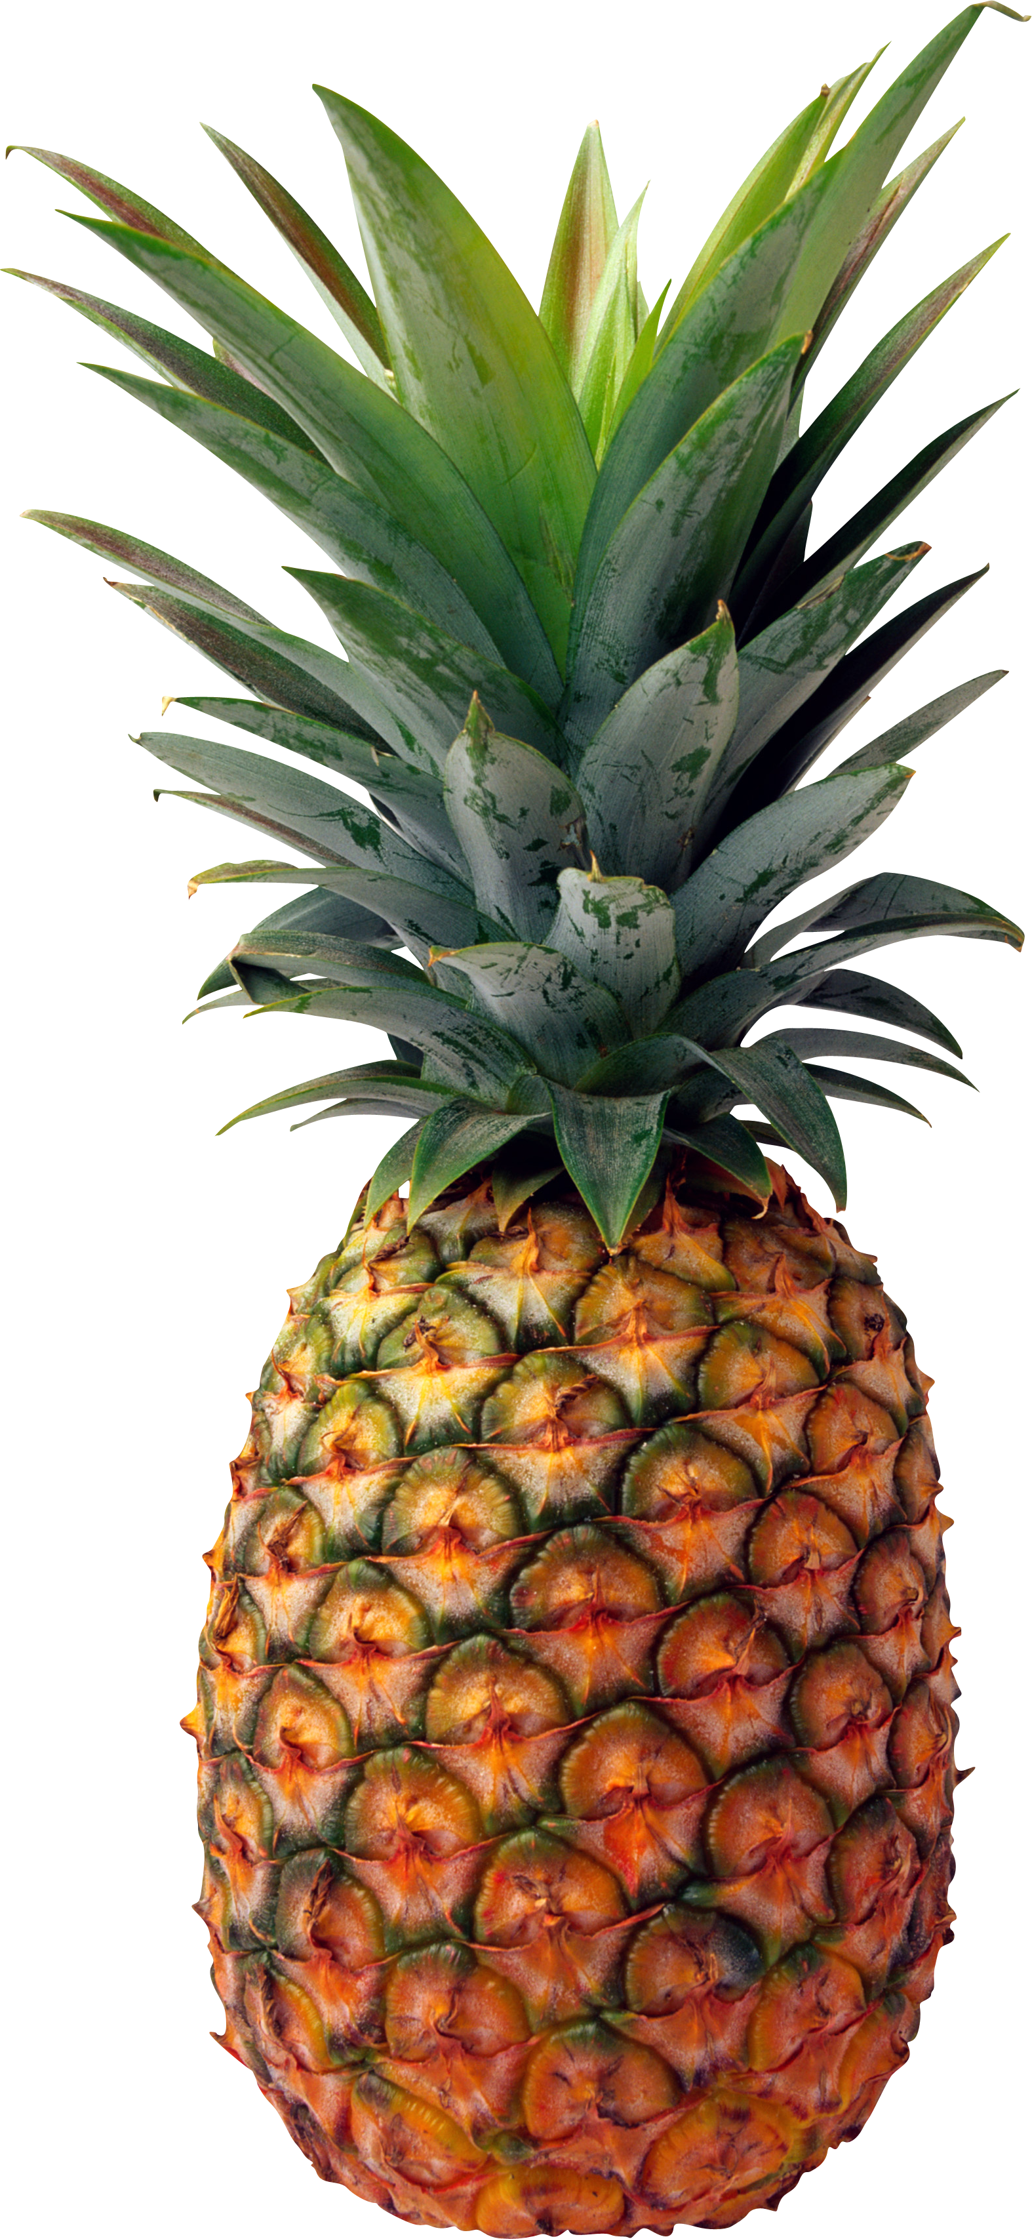
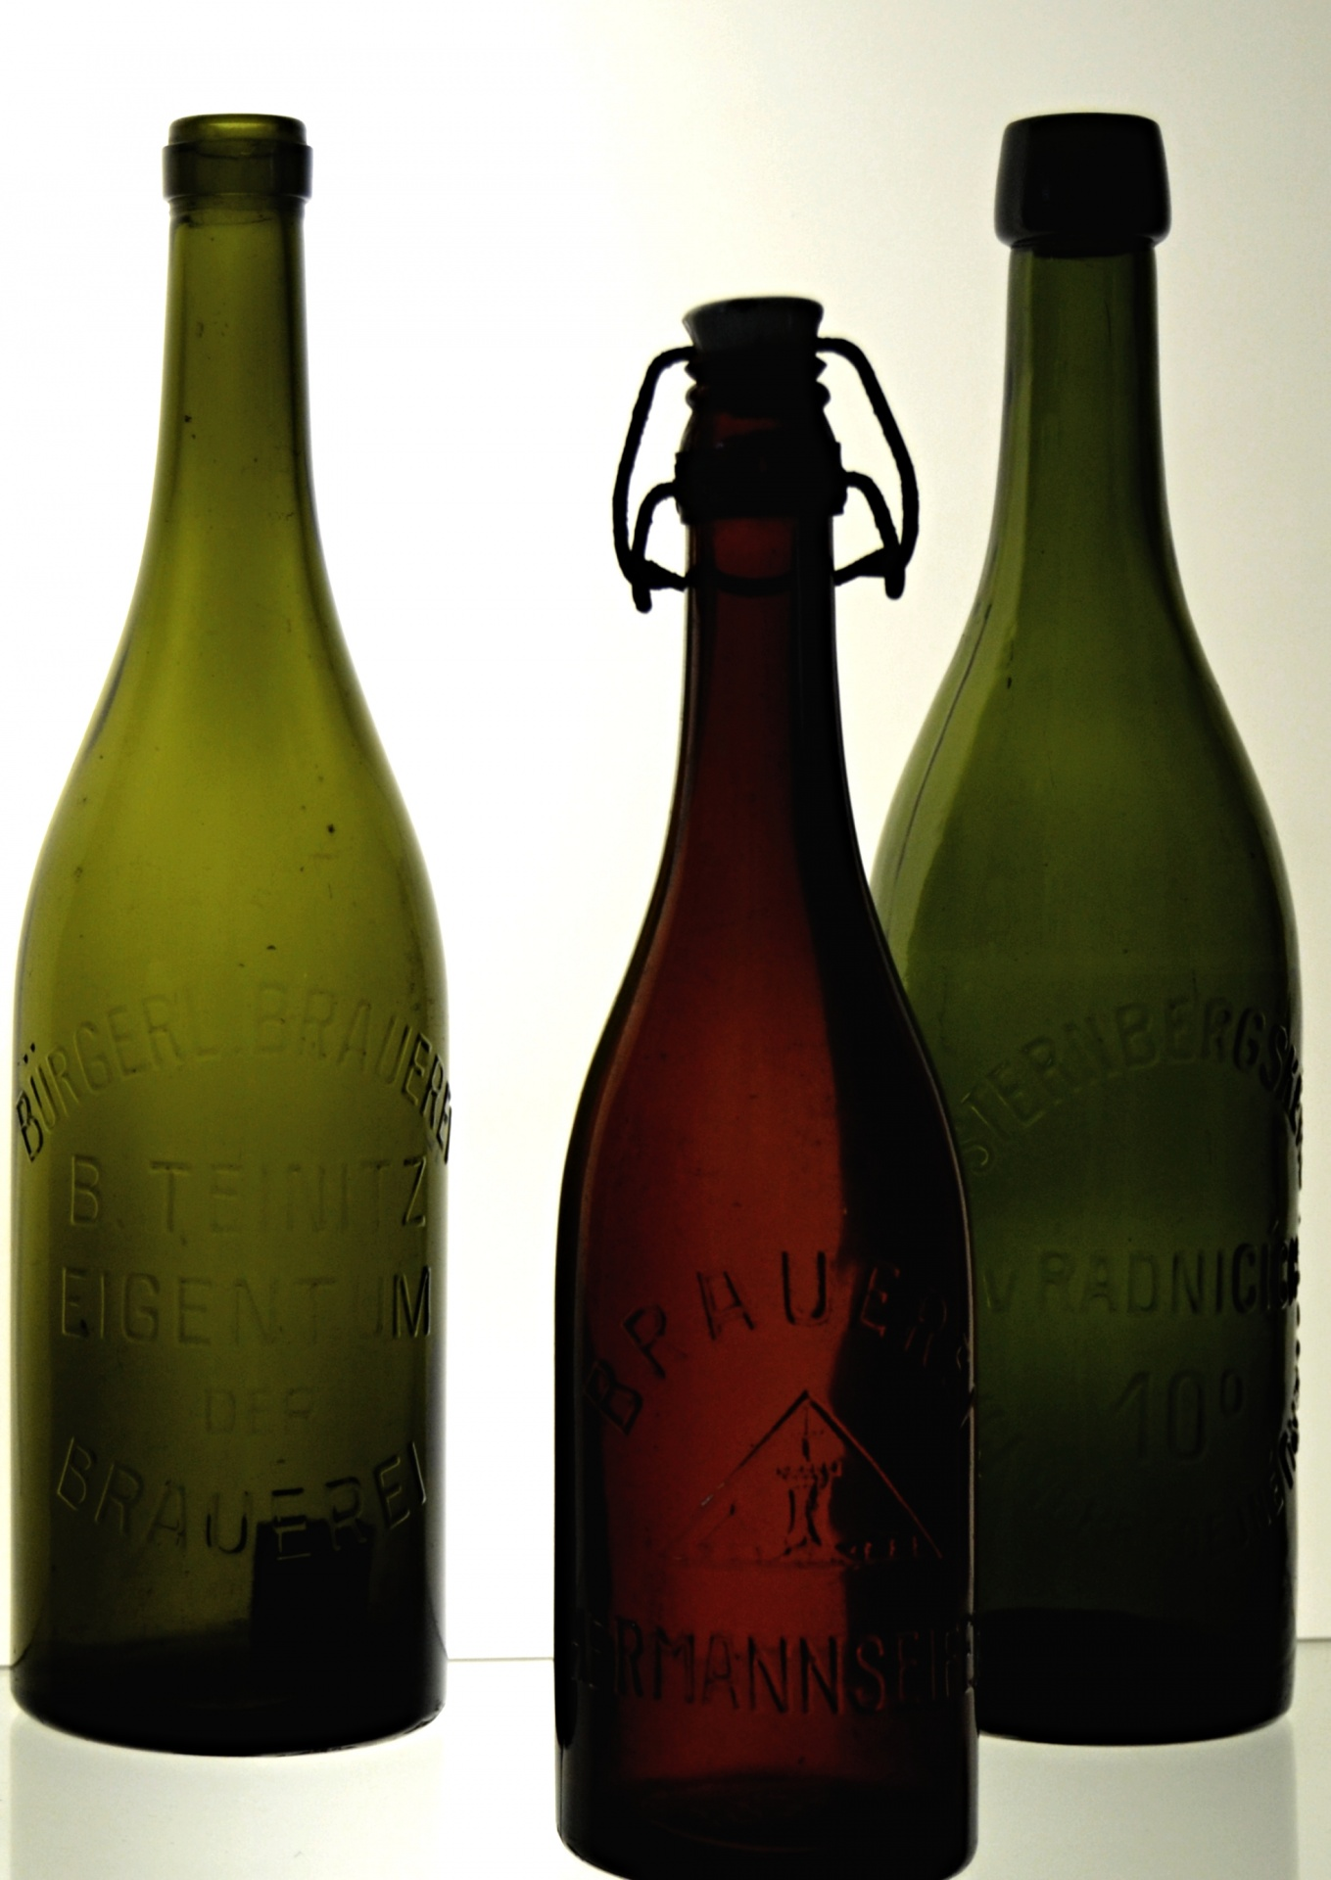
1. Cost Behavior Patterns and Assignment
2. Traditional Full Costing
Juice Factory: production process
3. ABC/ABM

Slide 10
1. Cost Behavior Patterns and Assignment
2. Traditional Full Costing
Determining costs per product unit is not as easy as most people assume:
Cost of apples --> Apple juice's cost (the same for all fruits)
Knives purchase/maintenance --> used for all products
Machines purchase/maintenance --> used for all products
Employees: hrs cleaning, pealing apples --> Apple juice's cost
Employees: coordinating or supervising plant --> used for all products
Electricity bill--> used for all products
Key question: how to allocate all product costs into specific products lines?
We will start by learning the traditional cost allocation method.
3. ABC/ABM

Slide 11
1. Cost Behavior Patterns and Assignment
2. Traditional Full Costing
Key concepts:
Direct Material
Direct Labor
Overhead: indirect material, labor, and other costs are closely associated with the manufacturing process but not tied to a specific product.
Indirect material: e.g., cleaning wipes for machine maintenance.
Indirect labor: supervisors' and maintenance staff's wages, engineers' wages.
Other: depreciation or rent of the factory, insurance expenses of machinery and factory, electricity bill.
The economic relevance of overhead costs has increased with technology as less labor force is used in manufacturing.
3. ABC/ABM

Slide 12
1. Cost Behavior Patterns and Assignment
2. Traditional Full Costing
Overhead allocation in the "Traditional" approach:
Step 1: Compute (o estimate) the manufacturing overhead ($) and total activity level.
Step 2: Compute the "overhead rate" as the ratio of the overhead costs to the activity level.
Step 3: Use overhead rate to assign OH cost to each product.
3. ABC/ABM

Slide 13
1. Cost Behavior Patterns and Assignment
2. Traditional Full Costing
What activity measures should be used to calculate the overhead rate across products?
Key principle: It should have a causal relationship between the metric and the related (overhead) costs.
These activity measures are technically called "cost drivers."
Most common cost drivers :
in manufacturing: unit produced, direct labor hours, direct labor cost, machine hours.
in customer service costs: number of product returns or client calls.
In cleaning costs: square meters.
in office supplies: number of employees.
In website costs: number of online orders.
3. ABC/ABM
Notes:
Next year: website means operating systems, not selling systems.

Slide 14
1. Cost Behavior Patterns and Assignment
2. Traditional Full Costing
Example
Product Details: Your company manufactures two products: A and B.
Direct Costs per Unit:
Product A: $20 for materials, $15 for labor
Product B: $30 for materials, $25 for labor
Total Overhead Costs: $60,000 for the period.
Total Production Units: 3,000 (1,000 units of A + 2,000 units of B)
The company uses "total production units" as the cost driver.
What is the total cost of product A? B?
Critical thinking:
(1) What if one unit of Product A consumes 20 times more machine maintenance or quality inspection hrs than Product B?
(2) Assume you are responsible for the profitability of Product B and have no price power. How is this (arbitrary) cost allocation affecting your performance evaluation?
3. ABC/ABM
Notes:
Calculate Direct Costs for Each Product Type
Direct Costs (Product A) = ($20 for materials + $15 for labor) * 1,000 units = $35,000
Direct Costs (Product B) = ($30 for materials + $25 for labor) * 2,000 units = $110,000
Step 2: Calculate the Overhead Rate
Overhead rate = $60,000 (Total Overhead Costs) / 3,000 (Total Production Units)
Overhead rate = $20 per unit
Step 3: Calculate Overhead Costs Allocated to Each Product
Overhead for Product A = $20 (Overhead rate) * 1,000 (Units of A) = $20,000
Overhead for Product B = $20 (Overhead rate) * 2,000 (Units of B) = $40,000
Finally Calculate the Total Cost per Unit for Each Product
Total Cost per Unit (Product A) = ($35,000 Direct Cost + $20,000 Overhead) / 1,000 units = $55 per unit
Total Cost per Unit (Product B) = ($110,000 Direct Cost + $40,000 Overhead) / 2,000 units = $75 per unit

Slide 15
1. Cost Behavior Patterns and Assignment
2. Traditional Full Costing
Example 2
See MS Excel file
3. ABC/ABM

Slide 16
1. Cost Behavior Patterns and Assignment
3. ABC
2. Traditional Full Costing
In the last decades, progress in robotics and IT has changed the ratio between direct labor and overhead.
More and more overhead costs are linked to drivers other than direct labor or unit produced.
This situation created severe distortions in the allocation of overhead costs.
Companies needed more information to be able to track the activities triggering overhead costs and assign the cost of these activities to the product…
That is how the Activity-Based Product Cost (ABC) assignment emerged.
The rationale behind ABC cost allocation is simple: products consume activities, and activities consume resources.

Slide 17
1. Cost Behavior Patterns and Assignment
3. ABC
2. Traditional Full Costing
ABC assignment is more precise than the traditional allocation of overhead costs since it assigns these costs to the products based on the use of the activities triggering overhead costs.
Steps:
1. List the activities performed in the factory
2. Aggregate activities into cost pools
3. Estimate the level of activity and cost for each cost pool.
4. Compute the overhead ABC rate for each cost pool.
5. Allocate overhead costs of each pool to products using ABC rates.
Notes:
Next year, use the 4 steps in pag 404 of the book of Weygandt.

Slide 18
1. Cost Behavior Patterns and Assignment
3. ABC
2. Traditional Full Costing
Steps:
1. List the activities performed in the factory
Activities: action or process involved in the production of inventory.
Examples of common manufacturing activities (and overhead costs):
• Taking orders
• Setting up machines
• Purchasing material
• Assembling products (ie, order assembling in Mcdonald)
• Inspecting products
• Providing customer service during the ordering process

Slide 19
1. Cost Behavior Patterns and Assignment
3. ABC
2. Traditional Full Costing
Steps:
2. Aggregate activities into cost pools
Overhead costs are assigned to each activity to become a cost pool. A cost pool is a list of costs incurred when related activities are performed.
Examples:
Activities | Cost Pool
Taking orders Verifying/confirming orders | Customer Order
Setting up machines Machine insurances, utilities | Production Machines
Preparing purchaces of materials Cost to move materials from reception into production department | Purchasing Materials
Inspection/Quality staff costs | Inspect Products
Cost of assembly machine Cost of label machine | Assemble Products
Computers' depreciation Online store maintenance | Technological production

Slide 20
1. Cost Behavior Patterns and Assignment
3. ABC
2. Traditional Full Costing
Steps:
3. Estimate the level of activity and total cost for each cost pool.
What activities drive the costs in that pool? (again, the concept of "cost driver", but now, not only one)
Examples:
Activity Cost Pool | Estimated Activity of the Cost drivers
Customer Order | # of orders
Production Machines | # of machine setups
Purchasing Materials | # Purchases requests
Inspect Products | # Inspectors or Hrs.
Assemble Products | # direct labor hours
Technological production | # online orders or visits.
How to determine the cost driver for an activity pool?
R: find an objective metric with a causal relationship with the cost of the activity pool ("the driver").

Slide 21
1. Cost Behavior Patterns and Assignment
3. ABC
2. Traditional Full Costing
Steps:
4. Compute the overhead ABC rate for each cost pool.
This step is similar to finding the traditional overhead rate.
However, each cost driver be linked to a different overhead rate.
This is why ABC is a more accurate method of allocating overhead.

Slide 22
1. Cost Behavior Patterns and Assignment
3. ABC
2. Traditional Full Costing
Steps:
5. Allocate overhead costs to products using ABC rates.
This step is equivalent to the last step in the traditional approach
Summary of the 5-step process into just 2 stages:
First, allocating overhead costs to the various activities to get a cost per activity.
Second, allocating the cost per activity to each product based on that product’s usage of the activities.

Slide 23
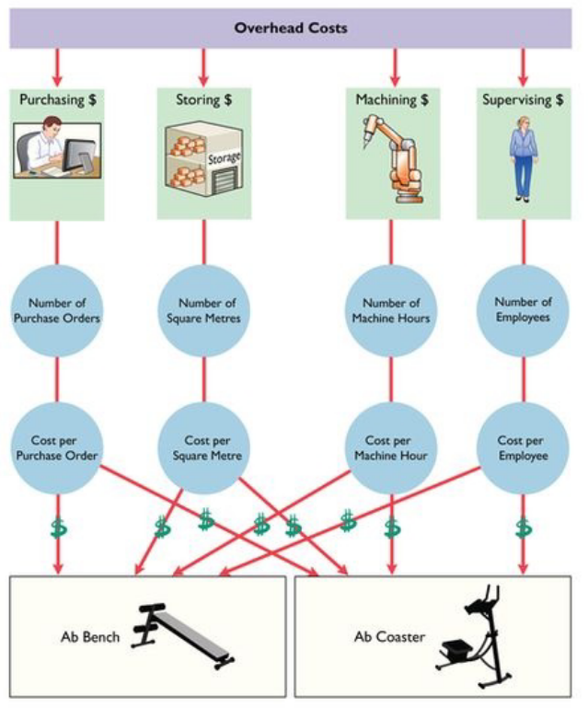
Weygandt et al (2018)

Slide 24
1. Cost Behavior Patterns and Assignment
3. ABC
2. Traditional Full Costing
Example:
Product Details: Your company manufactures two products: A and B.
Units Produced:
1,000 units of Product A
2,000 units of Product B
Direct Costs per Unit:
Product A: $20 for materials, $15 for labor
Product B: $30 for materials, $25 for labor
Total Overhead Costs: $60,000 for the period.
Activity Pools and Costs:
Machine Setup: $20,000
Quality Control: $25,000
Packaging: $15,000
Activity Metrics:
Machine Setups: 50 for Product A, 50 for Product B
Quality Control Tests: 200 for Product A, 100 for Product B
Packaging Instances: 1,000 for Product A, 2,000 for Product B
Compute total cost using the ABC method and compare it with the Traditional approach.
Notes:
Steps 1 to 3: information already provided.
Step 4: Calculate ABC Rates for Each Pool
Machine Setup rate = $20,000 / 100 setups = $200 per setup
Quality Control rate = $25,000 / 300 tests = $83.33 per test
Packaging rate = $15,000 / 3,000 packages = $5 per package
Step 5: Allocate Overhead Costs Based on Activities
Overhead for Product A = (50 setups * $200) + (200 tests * $83.33) + (1,000 packages * $5) = $10,000 + $16,666 + $5,000 = $31,666
Overhead for Product B = (50 setups * $200) + (100 tests * $83.33) + (2,000 packages * $5) = $10,000 + $8,333 + $10,000 = $28,333
Finally, calculate the Total Cost per Unit for Each Product
Total Cost per Unit (Product A) = ($35,000 Direct Cost + $31,666 Overhead) / 1,000 = $66.67 per unit
Total Cost per Unit (Product B) = ($110,000 Direct Cost + $28,333 Overhead) / 2,000 = $69.17 per unit
Conclusion: now the cost allocation is far more even. And more precise!

Slide 25
1. Cost Behavior Patterns and Assignment
3. ABC
2. Traditional Full Costing
Example 2
See MS file.

Slide 26
1. Cost Behavior Patterns and Assignment
3. ABC
2. Traditional Full Costing
Comparing and contrasting both cost allocation methods.
 | Traditional system | ABC
PROS | Simple to explain and implement. Cheap cost-information system. | More Accurate. Identify opportunities for improvements and unprofitable business.
CONS | Allocation base can be arbitrary Penalizes products with high volumen. | Complex to implement Expensive to implement, more sophisticated information system.

Slide 27
1. Cost Behavior Patterns and Assignment
3. ABC
2. Traditional Full Costing
How many Cost Activity Pools are appropriate?
Empirical evidence indicates that manufacturers identify between 50-150 activities with the respective cost drivers.
The number depends on:
- complexity of the production process.
a) manufacturing steps
b) number of different raw materials
c) coordination among divisions
d) level of automatization
- complexity of the product.
a) relevance of quality
b) number of elements or parts

Slide 28
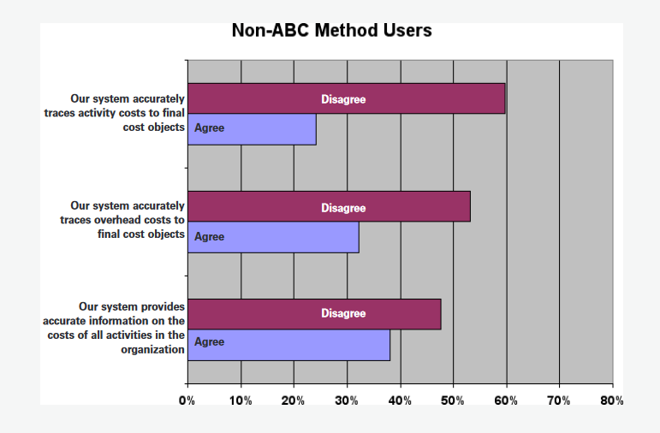
1. Cost Behavior Patterns and Assignment
3. ABC
2. Traditional Full Costing
How common is the ABC system?
Lawson (2009)

Slide 29
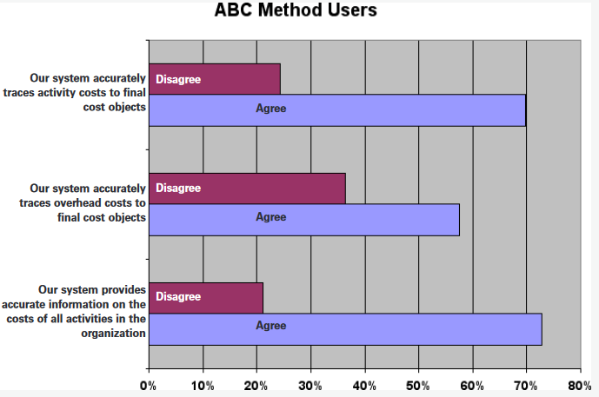
1. Cost Behavior Patterns and Assignment
3. ABC
2. Traditional Full Costing
How common is the ABC system?
Lawson (2009)

Slide 30
1. Cost Behavior Patterns and Assignment
3. ABC
2. Traditional Full Costing
How does a company know when to use ABC?
1) Product lines are very different in terms of volume of production or manufacturing complexity?
2) Product lines require many supporting services (cleaning, set-ups, utilities, inspections, moving parts/materials, coordination, and building maintenance).
3) Overhead Cost is a large % of total costs.
4) Managers are ignoring data provided by the existing cost system when deciding pricing or other producto decisions.

Slide 31
1. Cost Behavior Patterns and Assignment
2. Traditional Full Costing
Thanks
Check my website for an updated version of this presentation.
www.marceloortizm.com

